Slide 1

GLMS with gradient boosting trees
Part 1
Overview of concepts

Slide 2
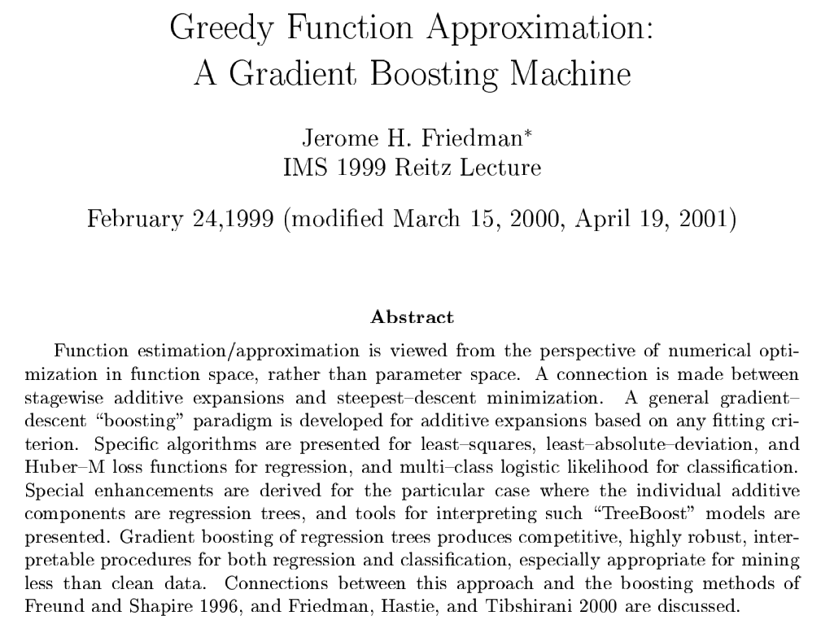
Origins of gradient boosting machines

Slide 3
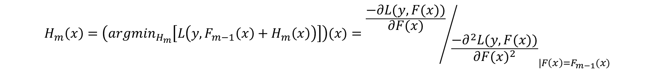
WHAT are gradient boosting trees?
$\hat{y}=F_{m}\left(x\right)=$ $F_{m−1}\left(x\right)+ γ∗H_{m}(x)$
Previous Predicted values
Weak Learner (Regression Trees) fitted on residuals of previous predictions
Predicted values
Learning rate
Pseudo residuals
$$H_{m}\left(x\right)=\left({argmin}_{H_{m}}\left[L\left(y,F_{m−1}\left(x\right)+H_{m}\left(x\right)\right)\right]\right)(x)={{\frac{−∂L(y,F(x))}{∂F(x)}}/{\frac{−∂^{2}L(y,F(x))}{∂{F(x)}^{2}}}}_{|F\left(x\right)=F_{m−1}(x)}$$

Slide 4






WHAT are gradient boosting trees?
$$F_{m}\left(x\right)=F_{m−1}\left(x\right)+ γ∗H_{m}\left(x\right)$$
$$=F_{0}\left(x\right)+γ∗H_{1}\left(x\right)+γ∗H_{2}\left(x\right)+…+γ∗H_{m}\left(x\right)$$
Driver Age
Area
Leaf 2
Leaf 3
Leaf 1
Vehicle Colour
Driver Age
Leaf 3
Leaf 2
Leaf 1
Vehicle Age
Leaf 1
Leaf 2
Is <30yrs?
Is Blue?
$$=F_{0}\left(x\right)$$
Yes
$$+…$$
$$+γ$$
Is <5yrs?
$$+γ$$
No
$$+γ$$
Yes
No
Yes
No
Is in Area A?
Predicted residuals
Predicted residuals
Is <45yrs?
Yes
No
Yes
No
Predicted residuals
Predicted residuals
Predicted residuals
Predicted residuals
Predicted residuals
Predicted residuals

Slide 5
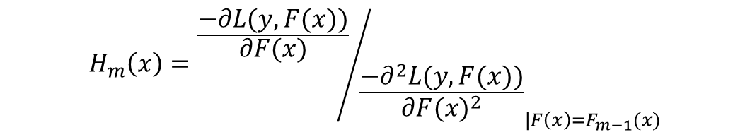
LETS Generalize the gradient boosted trees
$$\hat{y}=g^{−1}(F_{m}\left(x\right))=g^{−1}\left(F_{m−1}\left(x\right)+ γ∗H_{m}(x)\right)$$
Inverse Link function
Linear Predicted values
Previous Linear Predicted values
Learning rate
Weak Learner (Regression Trees) fitted on residuals of previous linear predictors
Pseudo residuals
$$H_{m}\left(x\right)={{\frac{−∂L(y,F(x))}{∂F(x)}}/{\frac{−∂^{2}L(y,F(x))}{∂{F(x)}^{2}}}}_{|F\left(x\right)=F_{m−1}(x)}$$

Slide 6
LETS FIT a Gradient Boosted Tree in EXCel
…

Slide 7
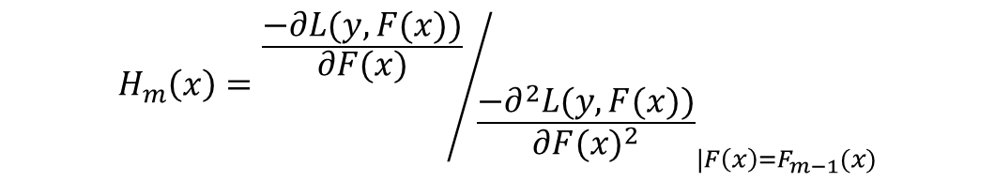
Boosting GLMS with Gradient Boosted TRees
$$\hat{y}=g^{−1}(F_{m}\left(x\right))=g^{−1}\left(F_{m−1}\left(x\right)+ γ∗H_{m}(x)\right)$$
$$\hat{y}=g^{−1}(F_{m}\left(x\right))=g^{−1}\left(F_{0}\left(x\right)+ \sum_{i=1}^{m}{γ∗H_{i}(x)}\right)$$
Expand equation
$$\hat{y}=g^{−1}(F_{m}\left(x\right))=g^{−1}\left(Xβ^{GLM}+ \sum_{i=1}^{m}{γ∗H_{i}(x)}\right)$$
Replace base value with GLM predictions
Inverse Link function
Linear Predicted values
Fitted GLM Linear Predictions
Weak Learner (Regression Trees) fitted on residuals of previous linear predictors
Learning rate
Pseudo residuals
$$H_{m}\left(x\right)={{\frac{−∂L(y,F(x))}{∂F(x)}}/{\frac{−∂^{2}L(y,F(x))}{∂{F(x)}^{2}}}}_{|F\left(x\right)=F_{m−1}(x)}$$

Slide 8
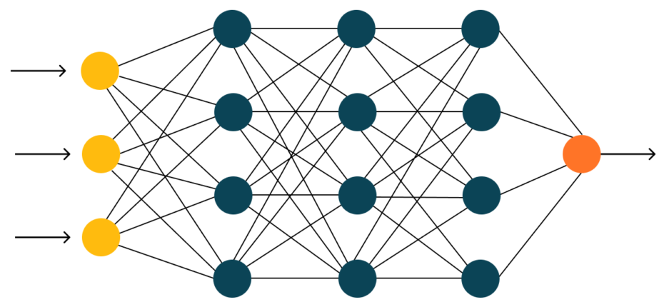
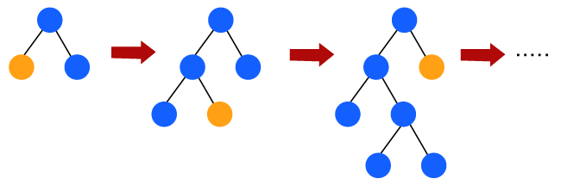
COMPARE WITH COMBINED ACTUARIAL NEURAL NETWORKS
$$\hat{y}=g^{−1}(F_{m}\left(x\right))=g^{−1}\left(Xβ^{GLM}+ \left\langle β^{NN},(Z^{L−1}∘Z^{L−2}∘…∘Z^{1})(x)\right\rangle \right)$$
Combined Actuarial Neural Networks
$$=g^{−1}\left(Xβ^{GLM}+ \right)$$
$$\hat{y}=g^{−1}(F_{m}\left(x\right))=g^{−1}\left(Xβ^{GLM}+ \sum_{i=1}^{m}{γ∗H_{i}(x)}\right)$$
“Combined Actuarial Gradient Boosted Trees”?
$$=g^{−1}\left(Xβ^{GLM}+ \right)$$

